Slide 1








PROJECT
VIDEO GAMES SALES

Slide 2



TEAM
1
4
ABANOB ESSAM AYAD
( SEC 1 )
MARIA AYMAN IBRAHIM
( SEC 7 )
2
5
SAMUEL MARZOUK REZK
(SEC 5)
MORA MONTASSER KHALF
( SEC 9 )
3
6
SEDEQ HALIM SADEQ
( SEC5 )
MANAR ISAAC KAMEL
( SEC 9 )

Slide 3


Introduction
We are now keeping pace with the latest advanced technology that has led to the emergence of millions of different types of games, which have become an essential part of this day and have also become a source of income for many people.
Therefore, we collected this data on most of the games that existed in previous periods to explain to us the development of these games and the most important places in which they are spread, and to explain to us the most important institutions and companies that produce these games.

Slide 4
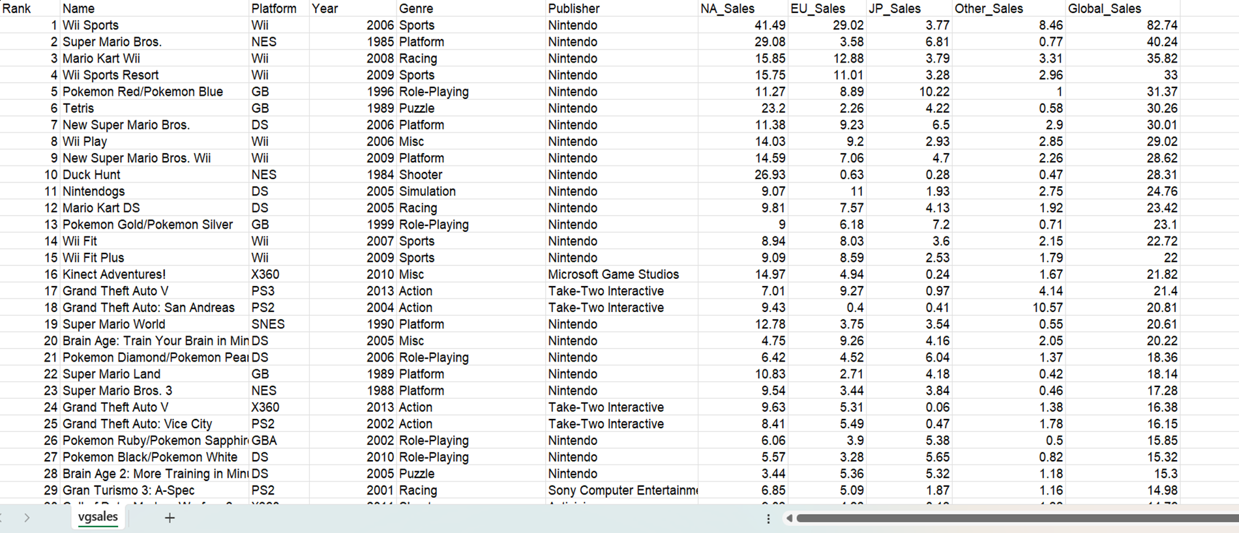
OUR DATASET CONTAINS 16598 ROWS AND 11 COLUMNS

Slide 5




About me
This data is divided into two collections(Games and Publisher
1) IN COLLECTION GAMES:
Name - The games name
Platform - Platform of the games release (i.e. PC,PS4, etc.)
Year - Year of the game's release
Genre - Genre of the game
EU_Sales - Sales in Europe (in millions)
JP_Sales - Sales in Japan (in millions)
Other_Sales - Sales in the rest of the world (in millions)
Global_Sales - Total worldwide sales.
NA_Sales - Sales in North America (in millions)

Slide 6
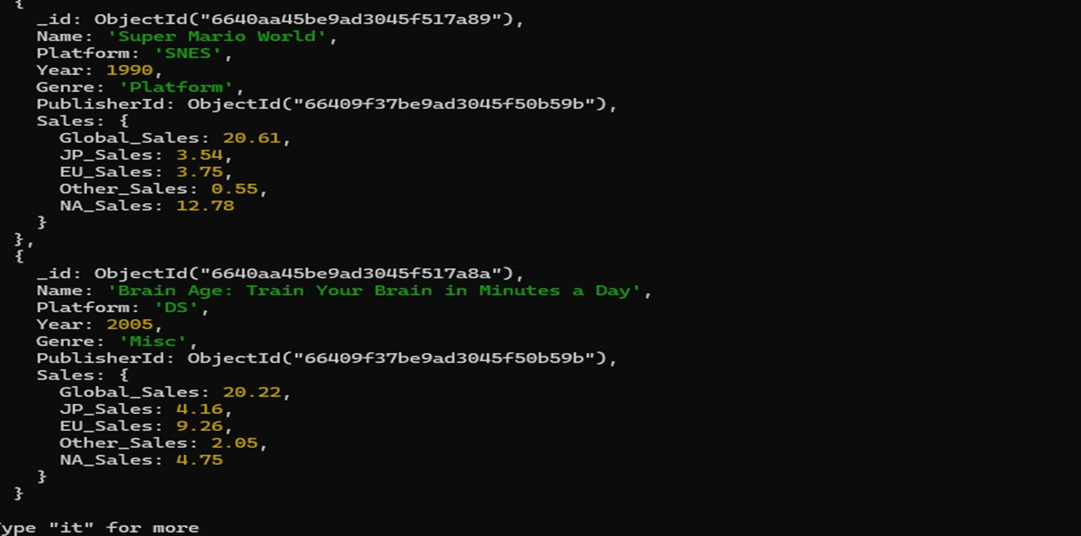

Slide 7
About me
This data is divided into two collections(Games and Publisher
2) IN COLLECTION PUBLISHER:
Publisher - Publisher of the game

Slide 8
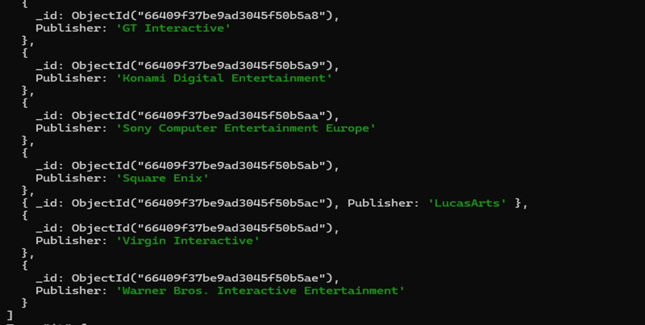

Slide 9
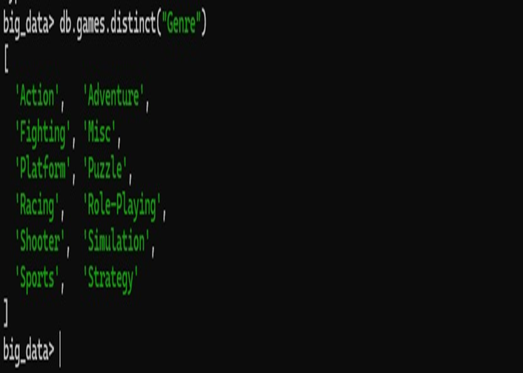
Using distinct with Genre Field

Slide 10
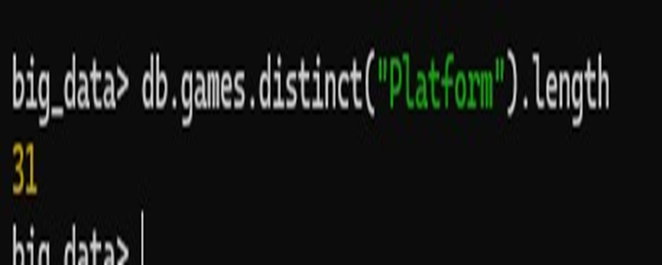
The Count of distinct Platforms

Slide 11
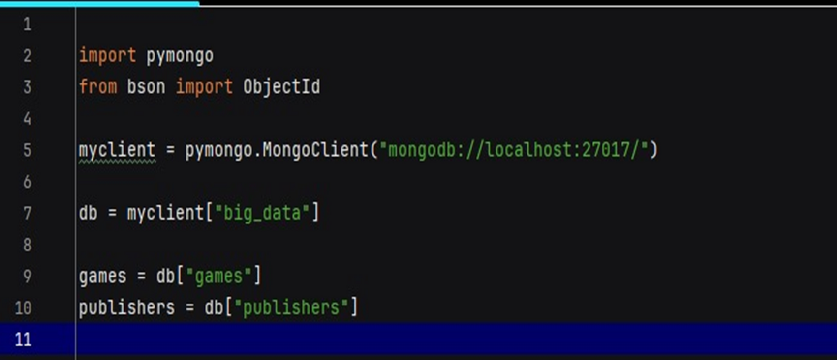
PREPARING CONNECTION

Slide 12

GUI (Tkinter)

Slide 13
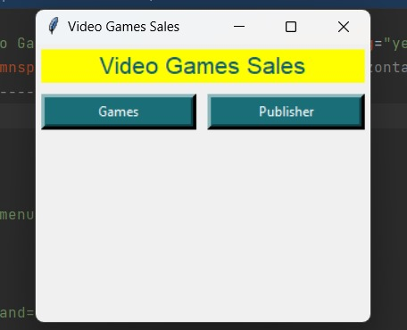
MAIN WINDOW

Slide 14
Publisher

Slide 15
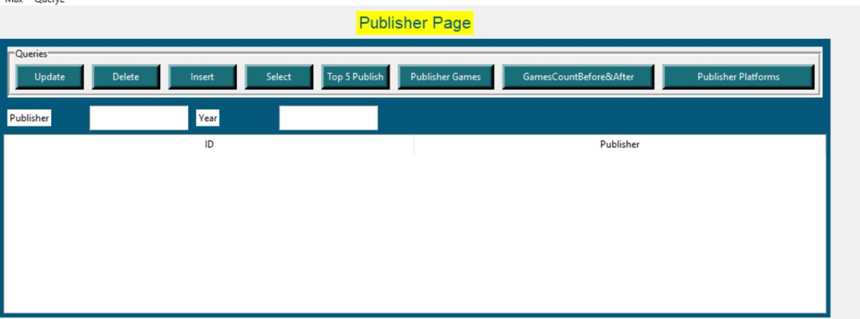
PUBLISHER WINDOW

Slide 16

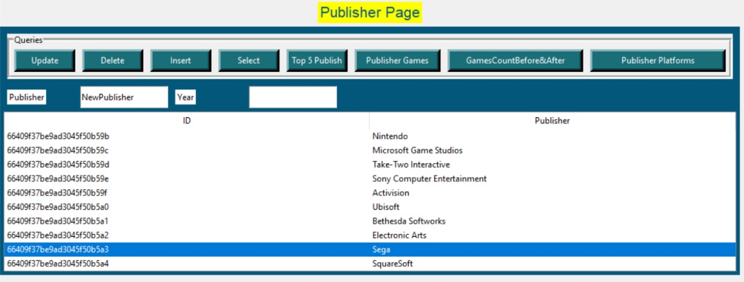
UPDATE (NAME PUBLISHER IN DATA)

Slide 17

DELETE ( PUBLISHER FROM DATA )

Slide 18
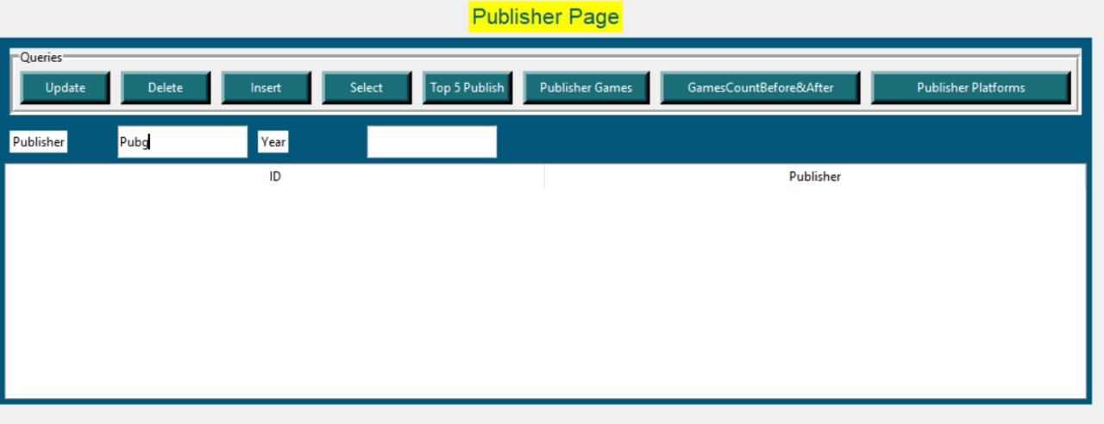
INSERT ( PUBLISHER IN DATA )

Slide 19
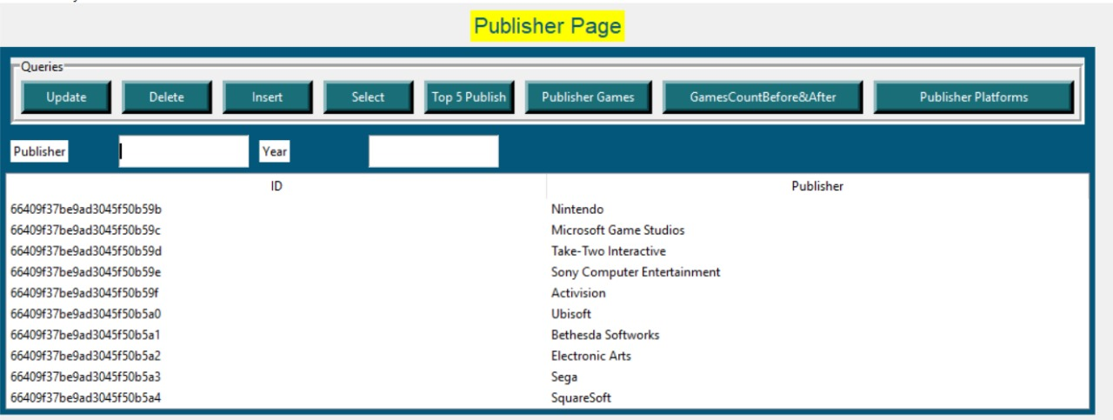
SELECT BUTTON RESULT (FIND ALL PUBLISHERS)

Slide 20
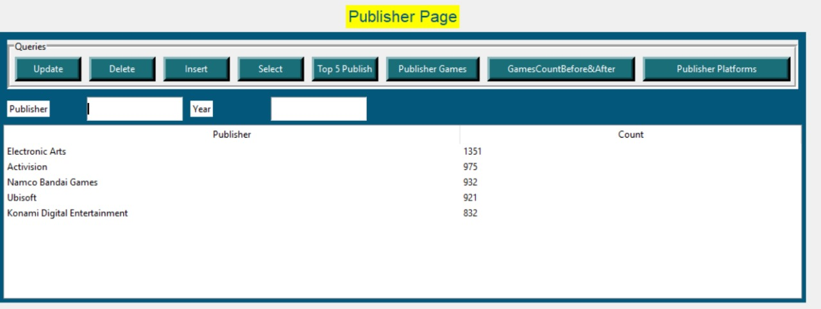
TOP 5 PUBLISHER OF GAMES

Slide 21
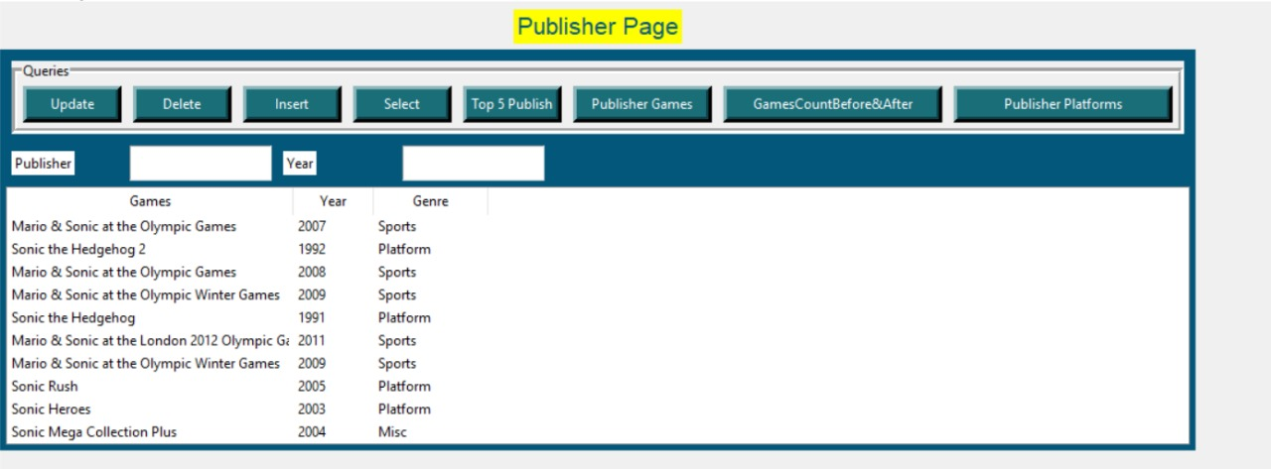
ALL GAMES OF SPECIFIC PUBLISHER "SEGA"

Slide 22
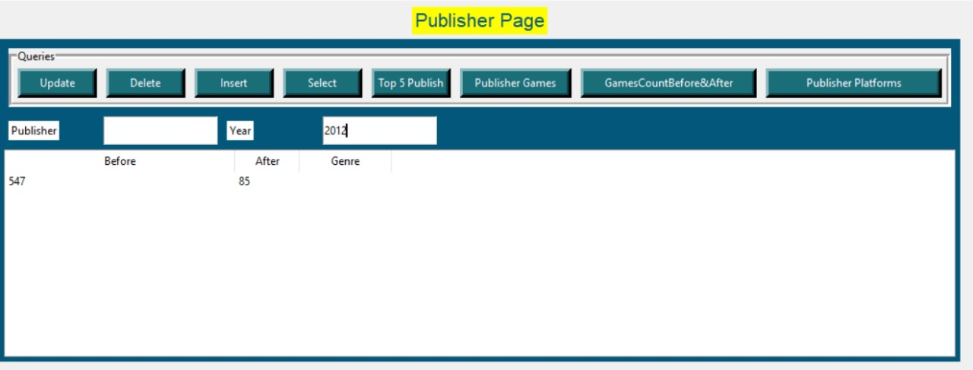
GAMES COUNT BEFORE AND AFTER 2000
FOR SPECIFIC PUBLISHER

Slide 23
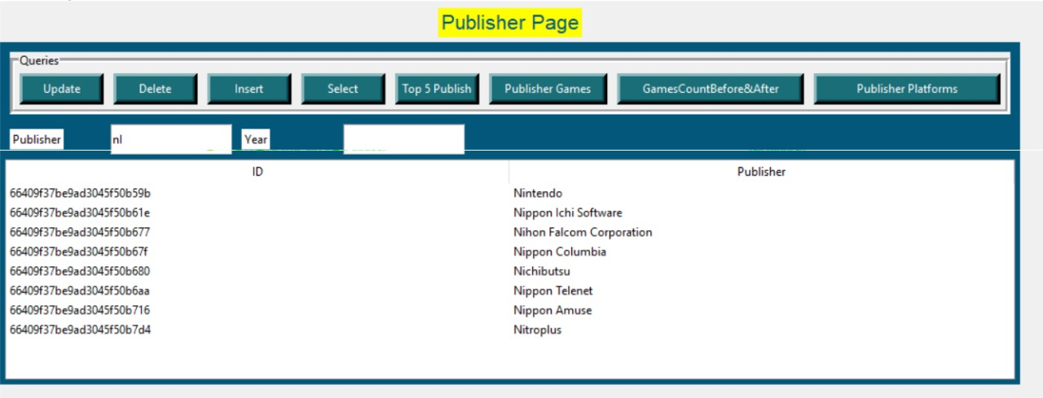
FIND BY PATTERN

Slide 24
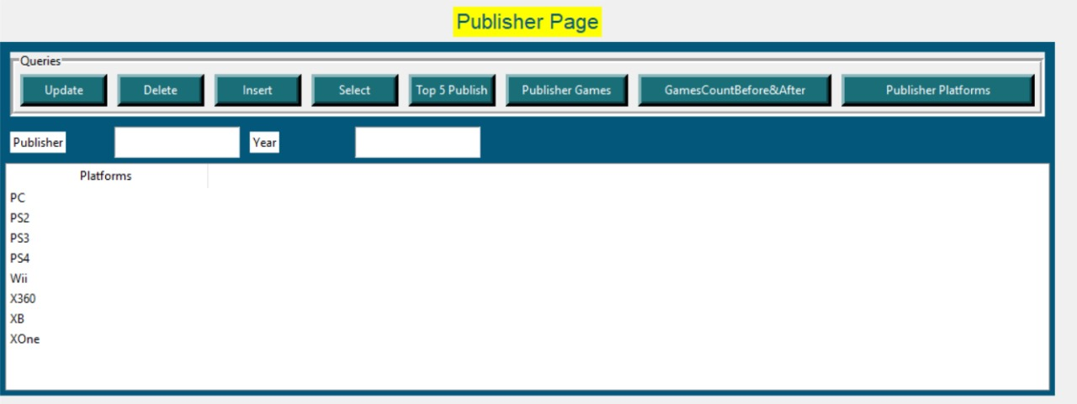
ALL PLATFORMS OF SPECIFIC PUBLISHER

Slide 25
GAMES

Slide 26
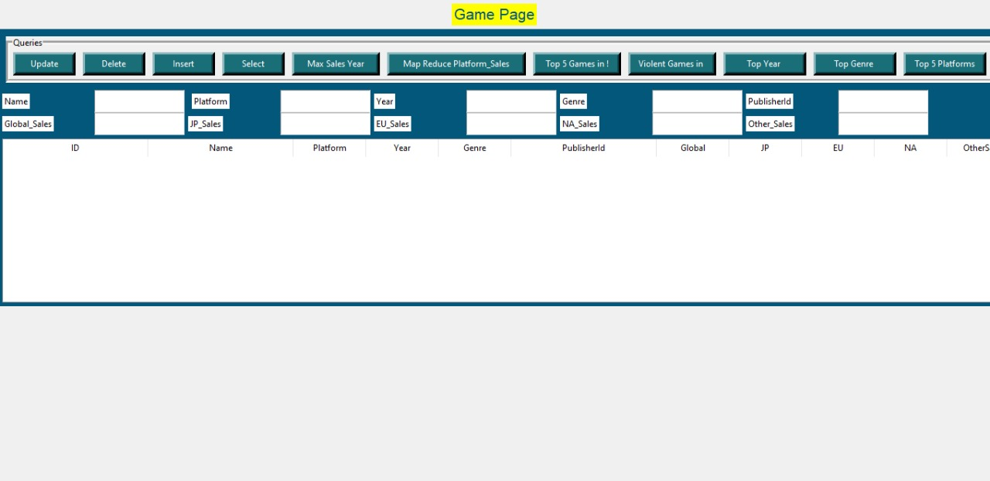
GAMES WINDOW

Slide 27
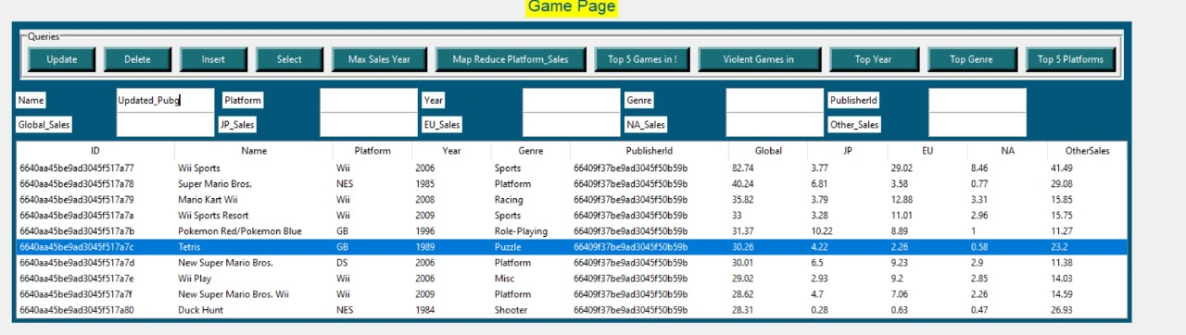
UPDATE (NAME GAME IN DATA)

Slide 28
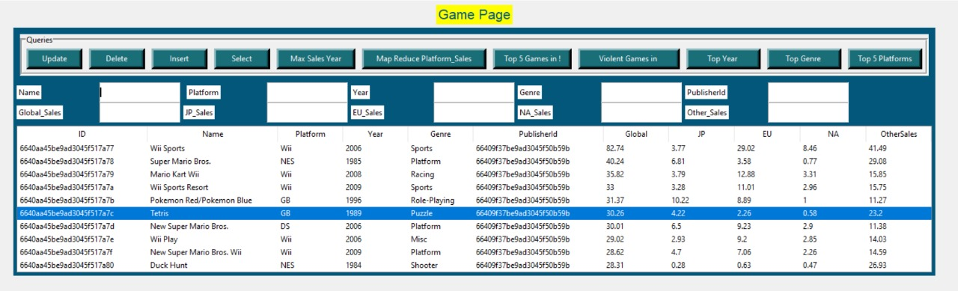
DELETE ( GAME FROM DATA )

Slide 29
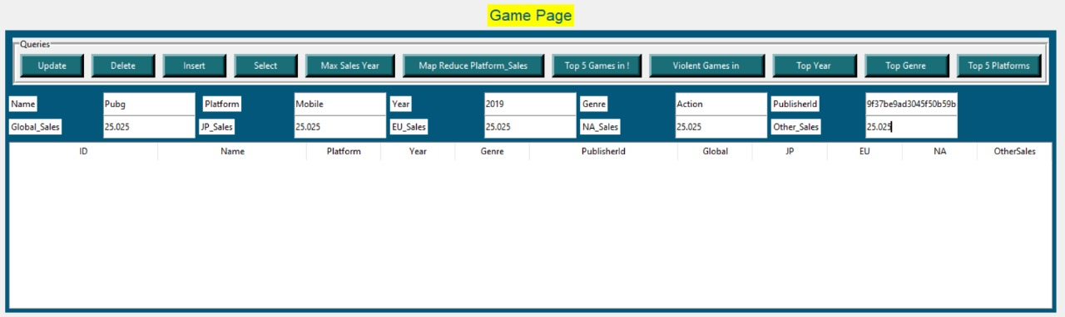
INSERT ( GAME IN DATA )

Slide 30
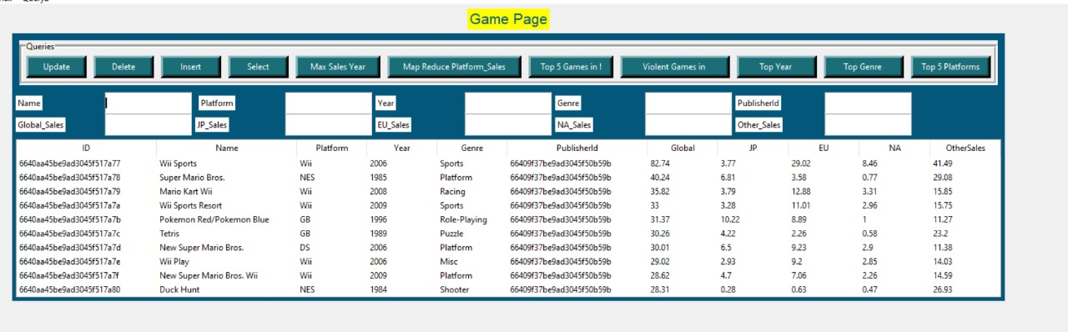
SELECT BUTTON RESULT (FIND ALL GAMES)

Slide 31
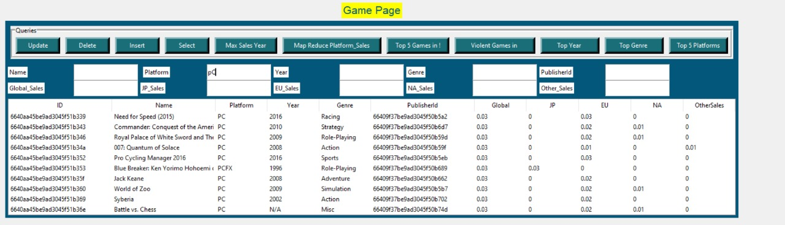
FIND BY PATTERN

Slide 32
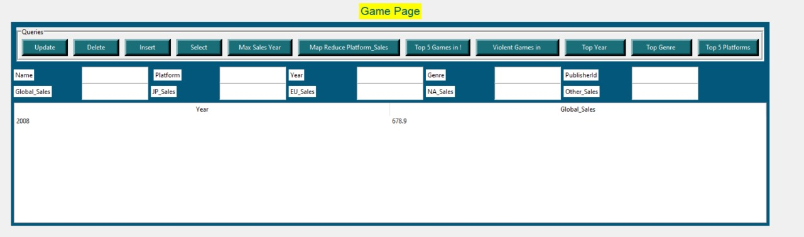
MAX SALES YEAR

Slide 33
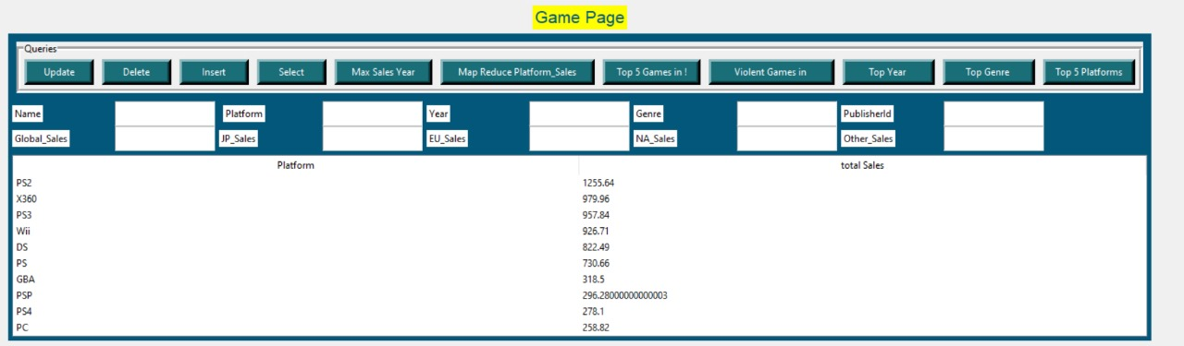
MAP REDUCE PLATFORM AND SALES

Slide 34
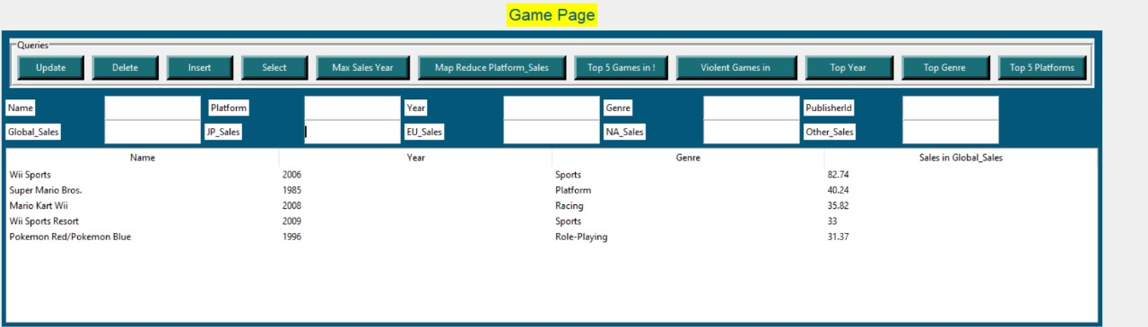
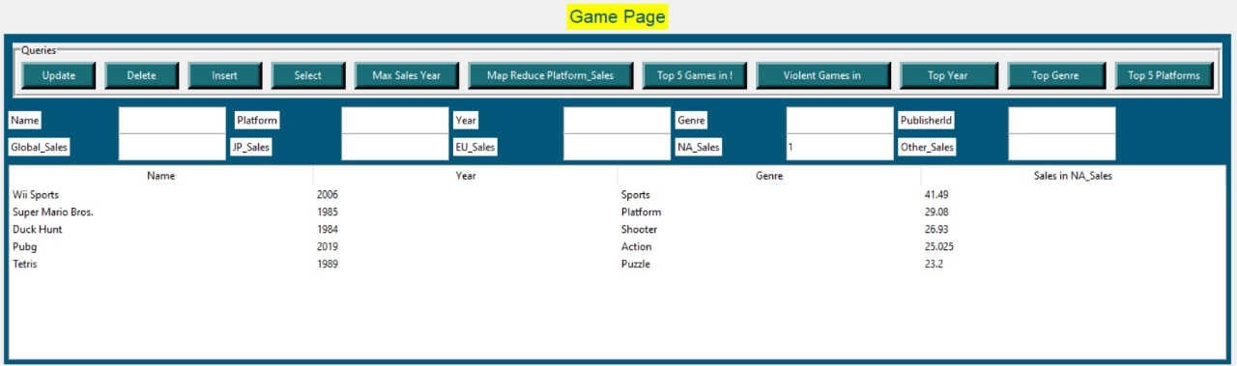
TOP 5 GAMES IN DESIRED LOCATION "GLOBAL"

Slide 35
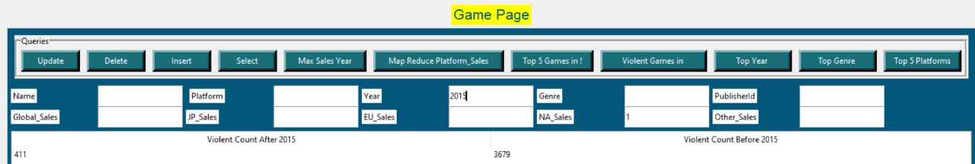
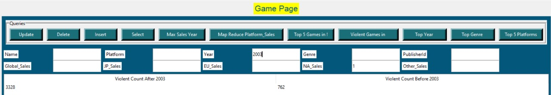
COUNT OF VIOLENT GAMES BEFORE AND AFTER DESIRED YEAR

Slide 36
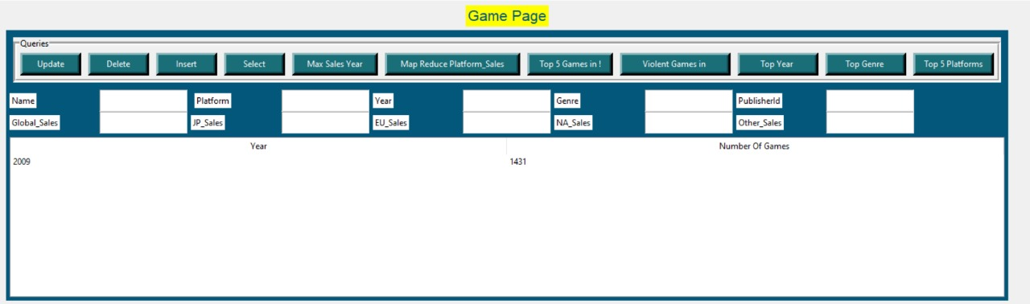
TOP YEAR OF RELEASED GAMES

Slide 37
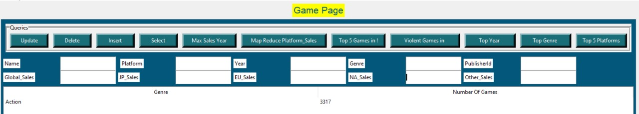
TOP GENRE

Slide 38
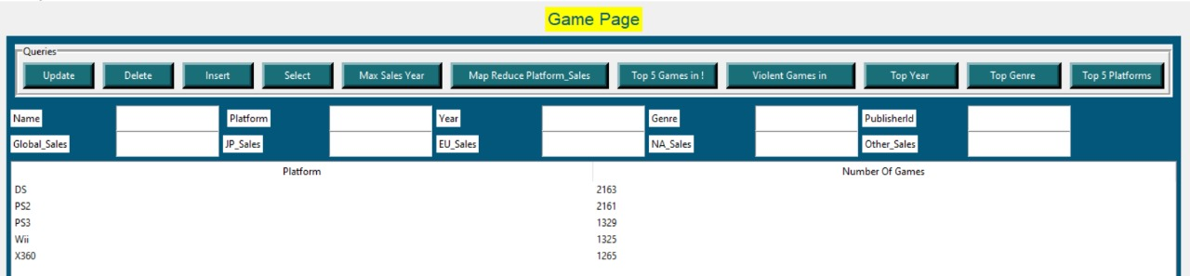
TOP 5 PLATFORMS

Slide 39

INDEX BY YEAR

Slide 40
INDEX BY GENRE

Slide 41

INDEX PUBLISHER ID

Slide 42

INDEX BY PUBLISHER NAME

Slide 43


Thanks!

